Slide 1
LinkedIn intake template

Slide 2
Introduction to LinkedIn Ad Formats and Specifications
Welcome to the definitive guide on LinkedIn Ad Formats and their specifications. In this presentation, we will navigate through the array of ad formats LinkedIn offers, each tailored to meet specific marketing goals and audience engagement. We’ll cover the Single Image Ad, Document Ad, Video Ad, Carousel Ad, and more, detailing their design recommendations and best practices.
Single Image ad
Document ad
Video ad
Carousel ad

Slide 3
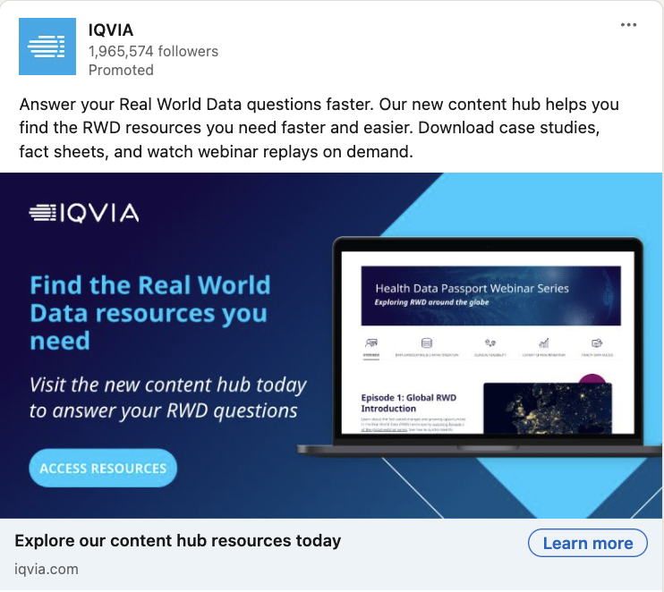
Single Image Ad
Single Image Ads: Capture attention with a single, compelling image and concise text to convey your message directly in the LinkedIn feed.
Headline: 70 characters
MAX :- 70 Char
Introductory
Introductory text: 150 characters
MAX :- 150
Image
Image
You can provide the SharePoint link or put all the image in folder and share
Headline
Here is some more information about the Single Image ad
Notes:
Single Image Ads on LinkedIn are useful for a variety of marketing objectives across the full funnel, from raising brand awareness to driving website conversions. Here are some scenarios where Single Image Ads can be particularly effective:
Brand Awareness: When you want to introduce your brand to a new audience, a compelling image with a clear message can capture attention and make a memorable impression.
Website Visits: If your goal is to drive traffic to your website, Single Image Ads with a strong call-to-action (CTA) can encourage professionals to click through and learn more about your offerings.
Engagement: To foster interactions such as likes, comments, and shares, Single Image Ads with engaging content can prompt users to engage with your post.
Lead Generation: By combining Single Image Ads with LinkedIn’s Lead Gen Forms, you can collect leads directly from the ad without requiring users to visit your site.
Website Conversions: When you aim to convert prospects into customers, Single Image Ads can direct users to your landing pages where they can take actions like making a purchase or signing up for a service.

Slide 4
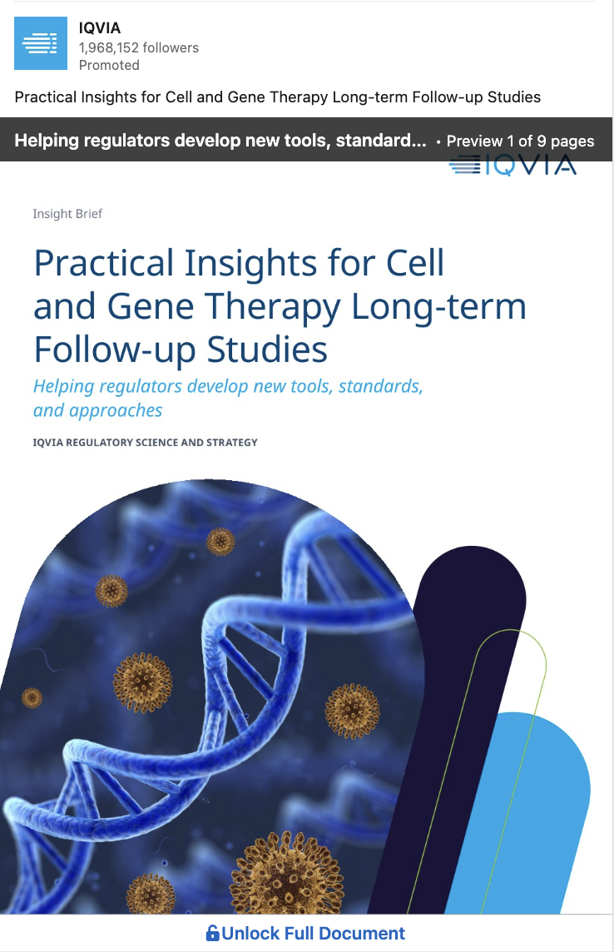
Document Ad
Document Ads: Allow you to share documents that users can download, useful for lead generation.
Headline: 70 characters
Introductory
MAX :- 70 Char
Headline
Introductory text: 150 characters
MAX :- 150 Char
Document
Document
You can provide the SharePoint link or put all the image in folder and share
Here is some more information about the Document ad
Notes:
LinkedIn Document Ads are particularly useful when you want to share in-depth content such as whitepapers, e-books, reports, or presentations with a professional audience. They are best used in the following scenarios:
Brand Awareness: If you’re looking to build awareness and establish thought leadership, sharing valuable content freely through Document Ads can help you reach and educate your target audience.
Engagement: When your goal is to engage with your audience and encourage them to interact with your content, Document Ads can provide a rich, full-screen experience that keeps users focused on your material¹.
Lead Generation: If you aim to collect high-quality leads, you can gate your documents with a Lead Gen Form. This way, users can access your content in exchange for their contact information, which can be a powerful way to generate leads for your business¹.
Educating Prospects: For B2B companies, agencies, or any brand with valuable insights to share, Document Ads can be a great way to captivate your audience by providing them with informative guides, industry reports, and comprehensive presentations².
Content Promotion: When you have fantastic content that you believe will be helpful to your audience, Document Ads allow you to educate and engage without explicitly promoting your brand. The focus is on delivering value and knowledge³.
Overall, Document Ads are a versatile tool that can support various objectives within your LinkedIn marketing strategy. They are especially effective when you have content that is not only promotional but also educational and beneficial to your audience¹²³.

Slide 5
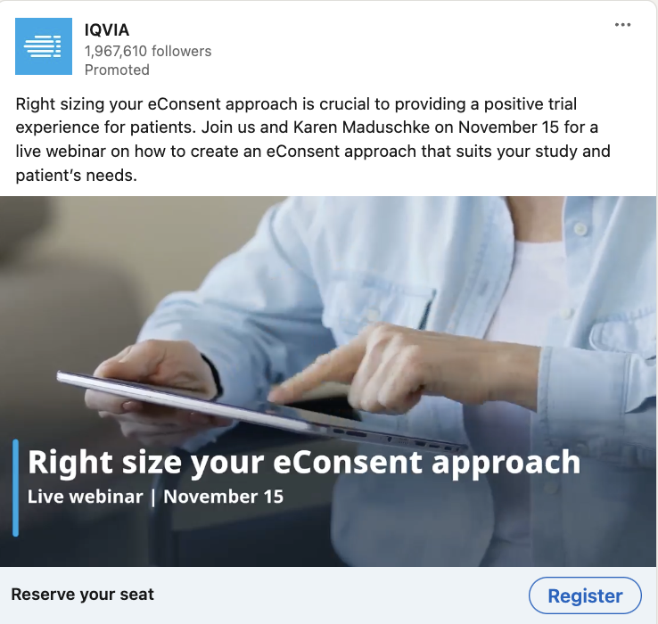
Video Ad
Video Ads: Ideal for storytelling, these ads auto-play in users’ feeds.
Headline: 70 characters
MAX :- 70 Char
Introductory
Introductory text: 150 characters
MAX :- 150 Char
Image
Video
You can provide the SharePoint link or put all the image in folder and share
Headline
Here is some more information about the Video ad

Slide 6
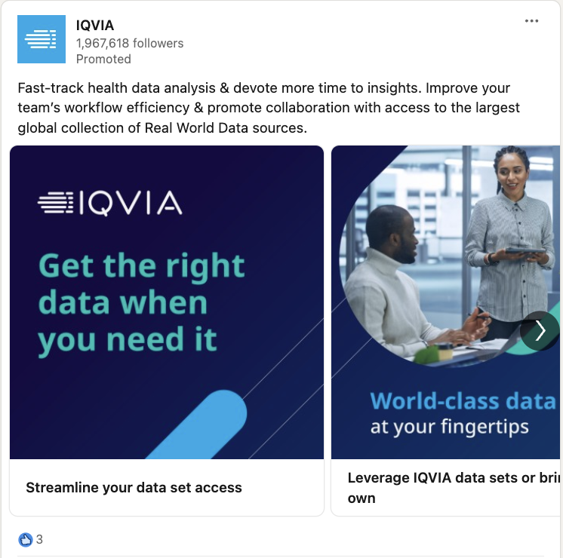
Carousel Ad
Carousel Ads: A series of images that users can swipe through, great for showcasing multiple products or telling a brand story.
Card headline: 45 characters
MAX :- 45 Char
Introductory
*Please have separate heading for each card
Introductory text: 255 characters
MAX :- 255 Char
Image
Images
You can provide the SharePoint link or put all the image in folder and share
Headline
Here is some more information about the Carousel ad

